Slide 1
Introduction to CSS

Slide 2
CSS Defined:
Short for "Cascading Style Sheets".
Determines how the elements in our HTML documents are displayed and formatted.
Designed to separate the content of a web page from the presentation of that content.
Enables us to make all pages of our website look similar and consistent (font, color, etc.).
Allows us to make site-wide formatting changes from a single location (rather than having to edit each page individually).

Slide 3
Three Ways to Use CSS:
Inline Style - CSS is placed directly into the HTML element.
Internal Style Sheet - CSS is placed into a separate area within the <head> section of a web page.
External Style Sheet - CSS is placed into a separate computer file and "connected" to a web page.

Slide 4
CSS Format Conflicts:
It's possible for CSS formatting to be defined in all three locations at the same time. For example, a paragraph element could contain an inline style (color:red) but the internal style sheet (color:blue) and the external style sheet (color:green) give conflicting instructions to the web browser.
Web browsers need a consistent way of "settling" this disagreement.

Slide 5
What is Meant by "Cascading"?
We use the term cascading because there is an established order of priority to resolve these formatting conflicts:
  Inline style (highest priority)
  Internal style sheet (second priority)
  External style sheet (third priority)
  Web browser default (only if not defined elsewhere)
For each HTML element, the browser will check to see which inline styles are defined, then those styles in the internal style sheet, and finally those styles in the external sheet. For all conflicts, it will use this priority system to determine which format to display on the page.
In the prior example, the paragraph would display as red, because the inline style "outranks" all the others.

Slide 6

Example: Inline Style
<h2 style="font-family:georgia; color:red; text-align:center">
CAUTION: Stormy Weather!
</h2>
PREVIEW:
A semicolon must follow each style declaration.
An inline style declaration like this one will affect only that particular element. In other words, other <h2> elements on the page will not be affected by this formatting.

Slide 7
Example: Internal Style Sheet
<head>
<style type="text/css">
h2 {font-family:georgia; color:red; text-align:center;}
</style>
</head>
For internal style sheets, all formatting declarations are placed inside the <style> element within the <head> section of the document. An element is listed and all the styling information follows, surrounded by opening and closing curly brackets, { }. A semicolon must still follow each style declaration.
Styles declared in the internal style sheet will affect all matching elements on the page. In this example, all <h2> elements on the page will be displayed in Georgia font and in red color.

Slide 8
Example: External Style Sheet
<head>
<link rel="stylesheet" type="text/css" href="style.css" />
</head>
style.css (separate file):
h2 {font-family:georgia; color:red; text-align:center;}
For external style sheets, a <link> tag is placed at the beginning of the <head> section of the document specifying the external style sheet (with a .css extension) to be used for formatting. The external style sheet uses the same syntax as the internal style sheet when listing elements and their styling.
Styles declared in an external style sheet will affect all matching elements on all web pages that link to the stylesheet. In this example, all <h2> elements on all pages using this style sheet will be displayed in Georgia font and in red color.

Slide 9
Internal vs. External Style Sheets
Internal style sheets are appropriate for very small sites, especially those that have just one page.
Internal style sheets might also make sense when each page of a site needs to have a completely different look.
External style sheets are better for multi-page websites that need to have a uniform look and feel to all pages.
External style sheets not only make for faster-loading sites (less redundant code) but also allow designers to make site-wide changes quickly and easily.

Slide 10
CSS Terminology and Syntax:
Correct syntax:
selector {property:value;}
p {color:red;}
Selector
Property
Value
Be careful to put the semicolon after each declaration. It is the single most common mistake made by those learning CSS.

Slide 11
Setting Multiple Properties:
p {
color:blue;
font-style:italic;
text-align:center;
}
You can define as many selectors as you wish for the element you are formatting.
In the above example, all paragraph elements will now show red italic text that is centered on the page.
Many designers choose to place the selector and the open bracket on a dedicated line and the closing bracket on its own line too. By doing this, all the selectors in between are aligned and easy to read.

Slide 12
Setting a Background with CSS:
body {
background-image:url('picture.gif');
background-repeat:repeat-x;
background-color:white;
}
With background-image, you can specify an image to be placed in the background of your web page.
If you specify a background image, you can also decide whether the image will "tile" across or down the screen. Possible values for the background-repeat property include repeat-x (horizontally only), repeat-y (vertical only), and no-repeat (no tiling at all). If you don't specify this property at all, by default the image will repeat up and down to fill the entire page.
You can use the background-color property to set one solid color for the background. Even if you specify a background image, it is good practice to specify a color too. If for some reason the background image is not available, the background color will be shown instead.

Slide 13
CSS Text Properties:
The following properties can be specified for any element that contains text, such as <h1> thru <h6>, <p>, <ol>, <ul>, and <a>:
Property Some Possible Values
text-align: center, left, right, justify
text-decoration: underline, line-through, blink
color: blue, green, yellow, red, white, etc.
font-family: Arial, Verdana, "Times New Roman"
font-size: large, 120%, 20px (pixels)
font-weight: bold, normal
font-style: italic, normal
For a full list of available color names, refer to the following page: http://www.w3.org/TR/css3-color/#svg-color

Slide 14
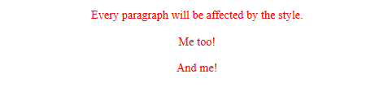
The element Selector
The element selector selects elements based on the element name.
You can select all <p> elements on a page like this (in this case, all <p> elements will be center-aligned, with a red text color)
<!DOCTYPE html>
<html>
<head>
<style>
p {
text-align: center;
color: red;
}
</style>
</head>
<body>
<p>Every paragraph will be affected by the style.</p>
<p id="para1">Me too!</p>
<p>And me!</p>
</body>
</html>

Slide 15

The id Selector
The id selector uses the id attribute of an HTML element to select a specific element.
The id of an element should be unique within a page, so the id selector is used to select one unique element!
To select an element with a specific id, write a hash (#) character, followed by the id of the element.
The style rule below will be applied to the HTML element with id="para1"
<!DOCTYPE html>
<html>
<head>
<style>
#para1 {
text-align: center;
color: red;
}
</style>
</head>
<body>
<p id="para1">Hello World!</p>
<p>This paragraph is not affected by the style.</p>
</body>
</html>

Slide 16
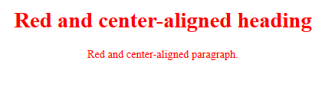
The class Selector
The class selector selects elements with a specific class attribute.
To select elements with a specific class, write a period (.) character, followed by the name of the class.
In the example below, all HTML elements with class="center" will be red and center-aligned:
<!DOCTYPE html>
<html>
<head>
<style>
.center {
text-align: center;
color: red;
}
</style>
</head>
<body>
<h1 class="center">Red and center-aligned heading</h1>
<p class="center">Red and center-aligned paragraph.</p>
</body>
</html>

Slide 17
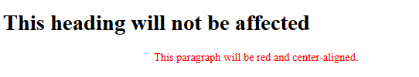
specific HTML
You can also specify that only specific HTML elements should be affected by a class.
In the example below, only <p> elements with class="center" will be center-aligned:
<!DOCTYPE html>
<html>
<head>
<style>
p.center {
text-align: center;
color: red;
}
</style>
</head>
<body>
<h1 class="center">This heading will not be affected</h1>
<p class="center">This paragraph will be red and center-aligned.</p>
</body>
</html>

Slide 18
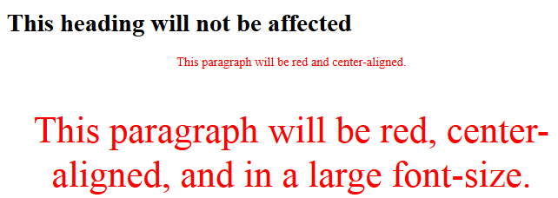
Refer More Classes
HTML elements can also refer to more than one class.
In the example below, the <p> element will be styled according to class="center" and to class="large":
<!DOCTYPE html>
<html>
<head>
<style>
p.center {
text-align: center;
color: red;
}
p.large {
font-size: 300%;
}
</style>
</head>
<body>
<h1 class="center">This heading will not be affected</h1>
<p class="center">This paragraph will be red and center-aligned.</p>
<p class="center large">This paragraph will be red, center-aligned, and in a large font-size.</p>
</body>
</html>

Slide 19
Grouping Selectors
It will be better to group the selectors, to minimize the code.
To group selectors, separate each selector with a comma.
If you have elements with the same style definitions, like this:
h1 {
text-align: center;
color: red;
}
h2 {
text-align: center;
color: red;
}
p {
text-align: center;
color: red;
}
It will be better to group the selectors, to minimize the code.
h1, h2, p {
text-align: center;
color: red;
}
Example: 11.grouping selector.html

Slide 20

Multiple Style Sheets
If some properties have been defined for the same selector (element) in different style sheets, the value from the last read style sheet will be used.
<!DOCTYPE html>
<html>
<head>
<link rel="stylesheet" type="text/css" href="mystyle.css">
<style>
h1 {
color: red;
}
h1 {
color: green;
}
</style>
</head>
<body>
​
<h1>This is a heading</h1>
<p>The style of this document is a combination of an external stylesheet, and internal style</p>
​
</body>
</html>

Slide 21
Multiple Style Sheets
Suppose external css h1 color is ”navy”.
If the internal style is defined after the link to the external style sheet, the <h1> elements will be "orange":
<head>
<link rel="stylesheet" type="text/css" href="mystyle.css">
<style>
h1 {
color: orange;
}
</style>
</head>
However, if the internal style is defined before the link to the external style sheet, the <h1> elements will be "navy":
<head>
<style>
h1 {
color: orange;
}
</style>
<link rel="stylesheet" type="text/css" href="mystyle.css">
</head>

Slide 22
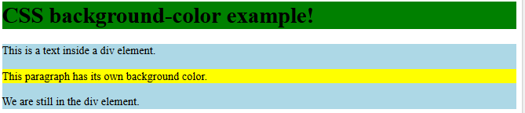
CSS Backgrounds
The CSS background properties are used to define the background effects for elements. CSS background properties:
    background-color
    background-image
    background-repeat
    background-attachment
    background-position
<html>
<head>
<style>
h1 {
background-color: green;
}
div {
background-color: lightblue;
}
p {
background-color: yellow;
}
</style>
</head>
<body>
<h1>CSS background-color example!</h1>
<div>
This is a text inside a div element.
<p>This paragraph has its own background color.</p>
We are still in the div element.
</div>
</body>
</html>

Slide 23
Background Image
Some images should be repeated only horizontally or vertically, or they will look strange, like this:
Example
body {
background-image: url("picture.jpg");
}
If the image above is repeated horizontally :(background-repeat: repeat-x;) for vertically :(background-repeat: repeat-y;)
Example
body {
background-image: url("picture.jpg");
background-repeat: repeat-y;
}
Background Image - Set position and no-repeat
Example
body {
background-image: url("picture.jpg");
background-repeat: repeat-x;
}

Slide 24
Background Image - Set position and no-repeat
Background Image - Set position and no-repeat: The background image is shown in the same place as the text. We want to change the position of the image, so that it does not disturb the text too much. The position of the image is specified by the background-position property:
Example
body {
background-image: url("picture.jpg");
background-repeat: no-repeat;
background-position: right top;
}
Background Image - Fixed position: To specify that the background image should be fixed (will not scroll with the rest of the page), use the background-attachment property:
Example
body {
background-image: url("picture.jpg");
background-repeat: no-repeat;
background-position: right top;
background-attachment: fixed;
}
Background - Shorthand property: To shorten the code, it is also possible to specify all the background properties in one single property. This is called a shorthand property.The shorthand property for background is background:
Example
body {
background: #ffffff url("picture.jpg"); no-repeat right top;
}

Slide 25
CSS Border Properties
The CSS border properties allow you to specify the style, width, and color of an element's border.
The border-style property specifies what kind of border to display.
The following values are allowed:
  dotted - Defines a dotted border
  dashed - Defines a dashed border
  solid - Defines a solid border
  double - Defines a double border
  groove - Defines a 3D grooved border. The effect depends on the border-color value
  ridge - Defines a 3D ridged border. The effect depends on the border-color value
  inset - Defines a 3D inset border. The effect depends on the border-color value
  outset - Defines a 3D outset border. The effect depends on the border-color value
  none - Defines no border
  hidden - Defines a hidden border
  The border-style property can have from one to four values (for the top border, right border, bottom border, and the left border).

Slide 26
CSS Margins
The CSS margin properties are used to generate space around elements.
The margin properties set the size of the white space outside the border.
With CSS, you have full control over the margins. There are CSS properties for setting the margin for each side of an element (top, right, bottom, and left).
All the margin properties can have the following values:
  auto - the browser calculates the margin
  length - specifies a margin in px, pt, cm, etc.
  % - specifies a margin in % of the width of the containing element
  inherit - specifies that the margin should be inherited from the parent element
The following example sets different margins for all four sides of a <p> element:
Example
p {
margin-top: 100px;
margin-bottom: 100px;
margin-right: 150px;
margin-left: 80px;
}
Margin - Shorthand Property
  To shorten the code, it is possible to specify all the margin properties in one property.
  The margin property is a shorthand property for the following individual margin properties:
  margin-top, margin-right, margin-bottom, margin-left
    Example
    p {
    margin: 100px 150px 100px 80px;
    }

Slide 27
CSS Margins Property
If the margin property has four values: margin: 25px 50px 75px 100px;
Means top margin is 25px, right margin is 50px, bottom margin is 75px, left margin is 100px
If the margin property has three values: margin: 25px 50px 75px;
Means top margin is 25px, right and left margins are 50px, bottom margin is 75px
If the margin property has two values: margin: 25px 50px;
  Means top and bottom margins are 25px, right and left margins are 50px
If the margin property has one value: margin: 25px;
Means all four margins are 25px
The auto Value: You can set the margin property to auto to horizontally center the element within its container.
Example div {
width: 300px;
margin: auto;
border: 1px solid red;
}
Element will then take up specified width, & remaining space will be split equally between left & right
margins
The inherit Value: Margin be inherited from the parent element. Example
div.container {
border: 1px solid red;
margin-left: 100px;
}
p.one {
margin-left: inherit;
}

Slide 28
Inheritance
Certain CSS properties are inherited by the descendents of the elements those styles are applied to.
For example, if you give the <body> element a color style of gray, all descendents of <body> will inherit the color gray, until you specify otherwise.
By setting a number of ‘basic’ styles in top-most elements, such as <body>, you can avoid having to style many descendent elements. This…
body { color: gray; }
Is much better than having to write this…
p, div, h1, h2, h3, ul, ol { color: gray; }
Note: inheritance is not the same as cascade!

Slide 29
CSS Padding
The CSS padding properties are used to generate space around content.
The padding clears an area around the content (inside the border) of an element.
With CSS, you have full control over the padding. There are CSS properties for setting the padding for each side of an element (top, right, bottom, and left).
CSS has properties for specifying the padding for each side of an element:
  padding-top
  padding-right
  padding-bottom
  padding-left
All the padding properties can have the following values:
  length - specifies a padding in px, pt, cm, etc.
  % - specifies a padding in % of the width of the containing element
  inherit - specifies that the padding should be inherited from the parent element
The following example sets different padding for all four sides of a <p> element:
Example p { padding-top: 50px;
padding-right: 30px;
padding-bottom: 50px;
padding-left: 80px;
}
Padding - Shorthand Property
  To shorten the code, it is possible to specify all the padding properties in one property.
  The padding property is a shorthand property for the following individual padding properties: padding-top, padding-right, padding-bottom, padding-left
  Example p {
  padding: 50px 30px 50px 80px;
  }

Slide 30
CSS padding Property
If the padding property has four values: padding: 25px 50px 75px 100px;
Means top padding is 25px, right padding is 50px, bottom padding is 75px, left padding is 100px
If the padding property has three values: padding: 25px 50px 75px;
Means top padding is 25px, right and left paddings are 50px, bottom padding is 75px
If the padding property has two values: padding: 25px 50px;
  Means top and bottom paddings are 25px, right and left paddings are 50px
If the padding property has one value: padding: 25px;
Means all four paddings are 25px

Slide 31
CSS Height and Width
The height and width properties are used to set the height and width of an element.
The height and width can be set to auto (this is default. Means that the browser calculates the height and width), or be specified in length values, like px, cm, etc., or in percent (%) of the containing block.
The height and width properties do not include padding, borders, or margins; they set the height/width of the area inside the padding, border, and margin of the element!
The max-width property is used to set the maximum width of an element.
  The max-width can be specified in length values, like px, cm, etc., or in percent (%) of the containing block, or set to none (this is default. Means that there is no maximum width).
  The problem occurs when the browser window is smaller than the width of the element. The browser then adds a horizontal scrollbar to the page.
  Using max-width instead, in this situation, will improve the browser's handling of small windows.

Slide 32

CSS Box Model
All HTML elements can be considered as boxes. In CSS, "box model" is used when talking about design and layout.
The CSS box model is essentially a box that wraps around: margins, borders, padding, and actual content.
  Content - The content of the box, where text and images appear
  Padding - Clears an area around the content. The padding is transparent
  Border - A border that goes around the padding and content
  Margin - Clears an area outside the border. The margin is transparent
Width and Height of an Element
div { width: 320px;
padding: 10px;
border: 5px solid gray;
margin: 0;
}
<div> element to have a total width of 350px
Calculation: 320px (width) + 20px (left + right padding)
+ 10px (left + right border) + 0px (left + right margin)
= 350px
The total width of an element should be calculated like this:
Total element width = width + left padding + right padding + left border + right border + left
margin + right margin
The total height of an element should be calculated like this:
Total element height = height + top padding + bottom padding + top border + bottom border +
top margin + bottom margin

Slide 33
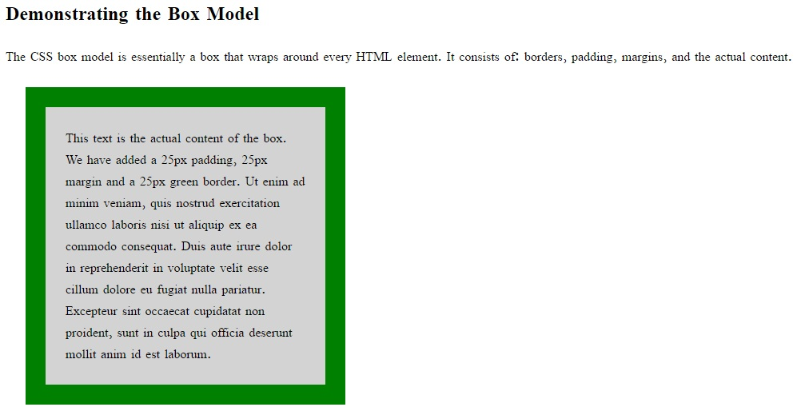
Box Model Example
<!DOCTYPE html>
<html>
<head>
<style>
div {
background-color: lightgrey;
width: 300px;
border: 25px solid green;
padding: 25px;
margin: 25px;
}
</style>
</head>
<body>
<h2>Demonstrating the Box Model</h2>
<p>The CSS box model is essentially a box that wraps around every HTML element. It consists of: borders, padding, margins, and the actual content.</p>
<div>This text is the actual content of the box. We have added a 25px padding, 25px margin and a 25px green border. Ut enim ad minim veniam, quis nostrud exercitation ullamco laboris nisi ut aliquip ex ea commodo consequat. Duis aute irure dolor in reprehenderit in voluptate velit esse cillum dolore eu fugiat nulla pariatur. Excepteur sint occaecat cupidatat non proident, sunt in culpa qui officia deserunt mollit anim id est laborum.</div>
</body>
</html>

Slide 34
CSS Outline
The CSS outline properties specify the style, color, and width of an outline.
An outline is a line that is drawn around elements (outside the borders)
However, the outline property is different from the border property - The outline is NOT a part of an element's dimensions; the element's total width and height is not affected by the width of the outline.
The outline-style property specifies the style of the outline.
The outline-style property can have one of the following values:
  dotted - Defines a dotted outline
  dashed - Defines a dashed outline
  solid - Defines a solid outline
  double - Defines a double outline
  groove - Defines a 3D grooved outline. The effect depends on the outline-color value
  ridge - Defines a 3D ridged outline. The effect depends on the outline-color value
  inset - Defines a 3D inset outline. The effect depends on the outline-color value
  outset - Defines a 3D outset outline. The effect depends on the outline-color value
  none - Defines no outline
  hidden - Defines a hidden outline

Slide 35
CSS text
The color property is used to set the color of the text
The text-align property is used to set the horizontal alignment of a text. A text can be left or right aligned, centered, or justified. Text-align property is set to "justify", each line is stretched so that every line has equal width, and the left and right margins are straight (like in magazines and newspapers)
The text-decoration property is used to set or remove decorations from text. Others values are underline, line-through, overline.
The text-transform property is used to specify uppercase & lowercase letters in text. Capitalize property capitalize the first letter of each word
The text-indent property is used to specify the indentation of the first line of a text means first line spacing.
The letter-spacing property is used to specify space between characters in a text.
The line-height property is used to specify the space between lines
The direction property is used to change the text direction of an element
The word-spacing property is used to specify the space between words in a text.
The text-shadow property adds shadow to text

Slide 36
CSS Fonts
Font Family: font-family property should hold several font names as a "fallback" system. If the browser does not support the first font, it tries the next font, and so on
font-style property is mostly used to specify text style. Property has three values: normal - The text is shown normally, italic - The text is shown in italics, oblique - The text is "leaning" (oblique is very similar to italic, but less supported)
font-size property sets the size of the text
font-weight property specifies the weight of a font. Values normal, lighter, bold, numeric value(900)
font-variant property specifies whether or not a text should be displayed in a small-caps font

Slide 37
CSS Icons
The simplest way to add an icon to your HTML page, is with an icon library, such as Font Awesome.
Add the name of the specified icon class to any inline HTML element (like <i> or <span>)
To use the Font Awesome icons, add the following line inside the <head> section of your HTML page:
<link rel="stylesheet" href="https://cdnjs.cloudflare.com/ajax/libs/font-awesome/4.7.0/css/font-awesome.min.css">
Note: No downloading or installation is required!

Slide 38
CSS Links
Styling Links: Links can be styled with any CSS property (e.g. color, font-family, background, etc.).
Example
a {
color: pink;
}
Links can be styled differently depending on what state they are in.
The four links states are:
  a:link - a normal, unvisited link
  a:visited - a link the user has visited
  a:hover - a link when the user mouse over it
  a:active - a link the moment it is clicked
There are some order rules: a:hover MUST come after a:link and a:visited a:active MUST come after a:hover
Background Color
The background-color property can be used to specify a background color for links:
Example
a:link {
background-color: yellow;
}

Slide 39
CSS Lists
In HTML, there are two main types of lists:
  unordered lists (<ul>) - the list items are marked with bullets
  ordered lists (<ol>) - the list items are marked with numbers or letters
The CSS list properties allow you to:
  Set different list item markers for ordered lists
  Set different list item markers for unordered lists
  Set an image as the list item marker
  Add background colors to lists and list items
An Image as The List Item Marker: The list-style-image property specifies an image as the list item marker
Example
  ul {
  list-style-image: url('sqpurple.gif');
  }
Position The List Item Markers: The list-style-position property specifies whether the list-item markers should appear inside or outside content flow:
Example
ul {
list-style-position: inside;
}

Slide 40



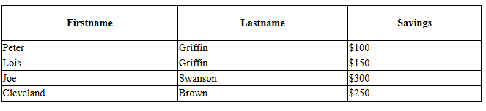
CSS Tables
Table Borders: To specify table borders in CSS, use the border property.
Example
table, th, td { border: 1px solid black;
}
Collapse Table Borders: The border-collapse property sets whether the table borders should be collapsed into a single border
Example
table { border-collapse: collapse;
}
table, th, td { border: 1px solid black;
}
Single Border: If you only want a border around the table, only specify the border property for <table>
table { border-collapse: collapse;
border: 1px solid black;
}
Table Width and Height
table, td, th {
border: 1px solid black;
}
table {
border-collapse: collapse;
width: 100%;
}
th {
height: 50px;
}
Hoverable Table: Use the :hover selector on <tr> to highlight table rows on mouse over
Example
tr:hover {background-color: #f5f5f5}

Slide 41
References
http://www.htmlandcssbook.com/code-samples/
http://www.w3schools.com/css/

